Slide 1
SRM INSTITUTE OF SCIENCE AND TECHNOLOGY, CHENNAI
ARTIFICIAL NEURAL NETWORKS
UNIT - IV
Department: AIML-B,C
Staff Name: L.Sasikala

Slide 2
Unit – IV
Radial basis functions
Information processing of an RBF network
Training of RBF networks
Growing of RBF networks
Comparing RBF networks and multilayer perceptron
Recurrent perceptron-like networks
Jordan networks
Elman networks
Training recurrent networks
Unfolding in time
Teacher forcing
Recurrent backpropagation
Training with evolution

Slide 3
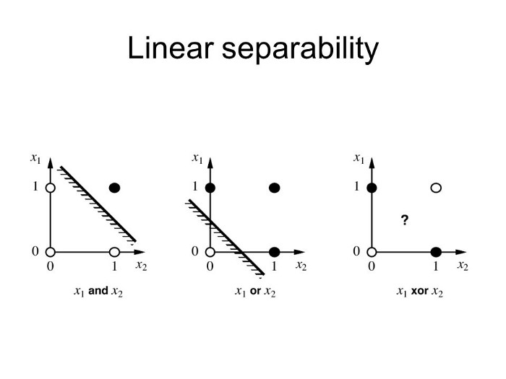
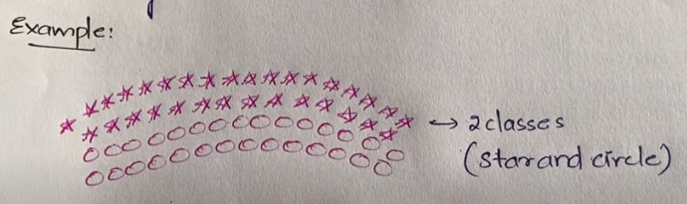
In Single Perceptron / Multi-layer Perceptron, we only have linear separability because they are composed of input and output layers (some hidden layers in MLP)
For example, AND, OR functions are linearly-separable & XOR function is not linearly separable.

Slide 4
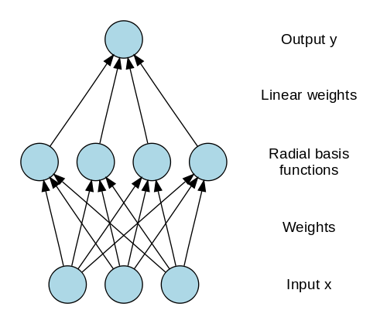
We at least need one hidden layer to derive a non linearity separation.
Our RBNN what it does is, it transforms the input signal into another form, which can be then feed into the network to get linear separability.
RBNN is structurally same as perceptron(MLP).
RBNN is composed of input, hidden, and output layer.
RBNN is strictly limited to have exactly one hidden layer.

Slide 5
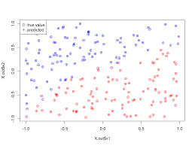

Slide 6
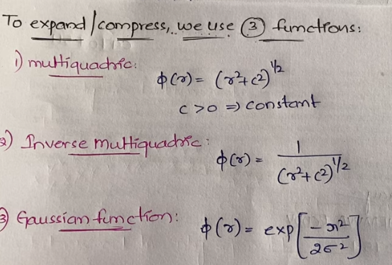

Slide 7
Introduction:
Radial basis function networks (RBF networks) are a paradigm of neural network, which was developed considerably later than that of perceptron.
Like perceptron, the RBF networks are built in layers, but in this case, they have exactly three layers, i.e. only one single layer of hidden neurons.
Like perceptron, the networks have a feedforward structure and their layers are completely linked.
Input layer does not participate in information processing.
The difference lies in the information processing itself and in the computational rules within the neurons outside of the input layer.

Slide 8
Components and structure of an RBF network:
Output neurons:
In an RBF network the output neurons only contain the identity/linear as activation function and one weighted sum as propagation function.
They do little more than adding all input values and returning the sum.
Hidden neurons / RBF neurons:
The layer in which they are located is referred to as RBF layer.
As propagation function, each hidden neuron calculates a norm that represents the distance between the input to the network and the so-called position of the neuron (center).
This is inserted into a radial activation function which calculates and outputs the activation of the neuron.

Slide 9

Input neuron:
Is an identity neuron.
It exactly forwards the information received.
The input neuron is represented by the symbol
Center of an RBF neuron:
The center c_{h} of an RBF neuron h is the point in the input space where the RBF neuron is located .
In general, the closer the input vector is to the center vector of an RBF neuron, the higher is its activation.
RBF neuron:
The so- called RBF neurons h have a propagation function f_{prop} that determines the distance between the center c_{h} of a neuron and the input vector x.
This distance represents the network input.
Network input is sent through a radial basis function f_{act} which returns the activation or the output of the neuron.
RBF neurons are represented by the symbol

Slide 10
RBF output neuron:
RBF output neurons Ω use the weighted sum as propagation function f_{prop}, and the identity as activation function f_{act}.
They are represented by the symbol

Slide 11
RBF network:
An RBF network has exactly three layers in the following order:
The input layer consisting of input neurons, the hidden layer (also called RBF layer) consisting of RBF neurons and the output layer consisting of RBF output neurons.
Each layer is completely linked with the following one, shortcuts do not exist, it is a feedforward topology.
The connections between input layer and RBF layer are unweighted, i.e. they only transmit the input.
The connections between RBF layer and output layer are weighted.
A bias neuron is not used in RBF networks.
The set of input neurons shall be represented by I, the set of hidden neurons by H and the set of output neurons by O.
Therefore, the inner neurons are called radial basis neurons because from their definition follows directly that all input vectors with the same distance from the center of a neuron also produce the same output value.

Slide 12
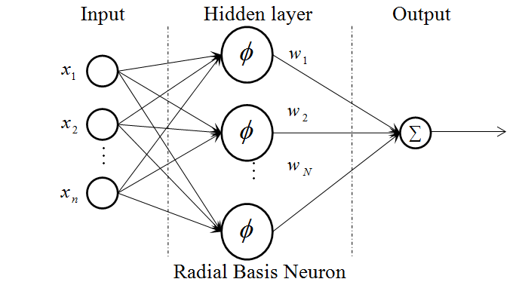

Slide 14
Information processing of an RBF network:
An RBF network receives the input by means of the unweight connections.
Then the input vector is sent through a norm (to provide positive value) so that the result is a scalar.
This scalar is processed by a radial basis function (Gaussian bells).
The output values of the different neurons n of the RBF layer or of the different Gaussian bells are added within the third layer basically, in relation to the whole input space, Gaussian bells are added here.
Suppose that we have a second, a third and a fourth RBF neuron and therefore four differently located centers.
Each of these neurons now measures another distance from the input to its own center and de facto provides different values, even if the Gaussian bell is the same.

Slide 15
Since these values are finally simply accumulated in the output layer, one can easily see that any surface can be shaped by dragging, compressing and removing Gaussian bells and subsequently accumulating them.
Here, the parameters for the superposition of the Gaussian bells are in the weights of the connections between the RBF layer and the output layer.
Furthermore, the network architecture offers the possibility to freely define or train height and width of the Gaussian bells – due to which the network paradigm becomes even more versatile.

Slide 16
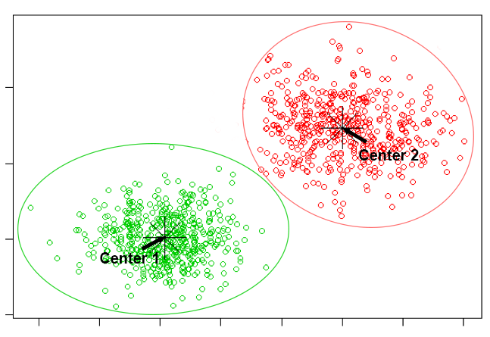

Slide 17
Information processing in RBF neurons:
RBF neurons process information by using norms and radial basis functions.
At first, let us take as an example a simple1-4-1 RBF network.
It is apparent that we will receive a one-dimensional output which can be represented as a function.
Additionally, the network includes the centers c1, c2. . . c4 of the four inner neurons h1, h2, . . . , h4, and therefore it has Gaussian bells which are finally added within the output neuron Ω.
The network also possesses four values which influence the width of the Gaussian bells.
On the contrary, the height of the Gaussian bell is influenced by the subsequent weights, since the individual output values of the bells are multiplied by those weights.

Slide 18
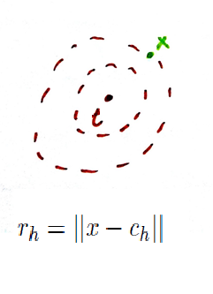
Since we use a norm to calculate the distance between the input vector and the center of a neuron h, we have different choices:
Often the Euclidian norm is chosen to calculate the distance:

Slide 19
Now that we know the distance r_{h} between the input vector x and the center c_{h} of the RBF neuron h, this distance has to be passed through the activation function.
A Gaussian bell:
It is obvious that both the center c_{h} and the width σ_{h} can be seen as part of the activation function fact.

Slide 21
The output y_{Ω} of an RBF output neuron Ω results from combining the functions of an RBF neuron to
Suppose that similar to the multilayer perceptron we have a set P , that contains |P | training samples (p, t). Then we obtain |P | functions of the form
i.e. one function for each training sample.
Of course, with this effort we are aiming at letting the output y for all training patterns p converge to the corresponding teaching input t.

Slide 24
Some analytical thoughts prior to the training:
The output y_{Ω} of an RBF output neuron Ω results from combining the functions of an RBF neuron to
Suppose that similar to the multilayer perceptron we have a set p , that contains |P| training samples (p, t).
Then we obtain |P| functions of the form
i.e. one function for each training sample.
Of course, with this effort we are aiming at letting the output y for all training patterns p converge to the corresponding teaching input t.

Slide 25
Weights can simply be computed as solution of a system of equations:
We have |P| equations.
Now let us assume that the widths σ₁, σ₂, . . . , σ_{k}, the centers c₁, c₂, . . . , c_{k} and the training samples p including the teaching input t are given.
We are looking for the weights w_{h,Ω} with |H| weights for one output neuron Ω.
Thus, our problem can be seen as a system of equations since the only thing we want to change at the moment are the weights.
T is the vector of the teaching inputs for all training samples.
M is the |P|x|H| matrix of the outputs of all |H| RBF neurons to |P| samples
M ⁻¹ is the |P|=|H|, the square matrix (n x n matrix) and we can therefore attempt to invert it.
G is the vector of the desired weights.
E is a unit matrix with the same size as G.

Slide 26
This demands a distinction of cases concerning the number of training samples |P| and the number of RBF neurons |H|:
|P|=|H|:
If the number of RBF neurons equals the number of patterns, i.e., |P|=|H| the equation can be reduced to a matrix multiplication
In the case |P|=|H| there is exactly one RBF neuron available per training sample.
This means, that the network exactly meets the P existing nodes after having calculated the weights, i.e. it performs a precise interpolation.

Slide 27
|P|<|H|:
The system of equations is under-determined, there are more RBF neurons than training samples |P|<|H|
Certainly, this case normally does not occur very often.
In this case, there is a huge variety of solutions, we can select one set of weights out of many obviously possible ones.
|P|>|H|:
In this case, there are significantly more training samples than RBF neurons, that means |P|>|H|
Thus, we again want to use the generalization capability of the neural network.
If we have more training samples than RBF neurons, we cannot assume that every training sample is exactly hit.
So, if we cannot exactly hit the points and therefore cannot just interpolate as in the aforementioned ideal case with |P|=|H|

Slide 28
We must try to find a function that approximates our training set P as closely as possible.
To solve the system of equations, we have to find the solution M of a matrix multiplication
The problem is that this time we cannot invert the |P|x|H| matrix M because it is not a square matrix (here, is true).
Here, we have to use the Moore-Penrose pseudo inverse M ⁺ which is defined by
Although the Moore-Penrose pseudo inverse is not the inverse of a matrix, it can be used similarly in this case1.

Slide 29
We get equations that are very similar to those in the case of |P| = |H|:
Another reason for the use of the Moore-Penrose pseudo inverse is the fact that it minimizes the squared error.
The estimate of the vector G corresponds to the Gauss-Markov model known from statistics, which is used to minimize the squared error.
Do not mistake the T in M^{T} (of the transpose of the matrix M ) for the T of the vector of all teaching inputs.

Slide 30

The generalization on several outputs is trivial and not quite computationally expensive:
We have found a mathematically exact way to directly calculate the weights.
What will happen if there are several output neurons i.e. |O|>1, with O being, as usual, the set of the output neurons Ω?
The additional output neurons have their own set of weights while we do not change the σ and c of the RBF layer.
Thus, in an RBF network it is easy for given σ and c to realize a lot of output neurons since we only have to calculate the individual vector of weights
for every new output neuron Ω, whereas the matrix M ⁺, which generally requires a lot of computational effort, always stays the same.
So it is quite inexpensive – at least concerning the computational complexity – to add more output neurons.

Slide 31
Computational effort and accuracy:
For realistic problems it normally applies that there are considerably more training samples than RBF neurons,
i.e. |P| |H|
We can, without any difficulty, use 10⁶ training samples.
Theoretically, we could find the terms for the mathematically correct solution, but such calculations often seem to be imprecise and very time-consuming.
Our computers can only provide us with approximations of the pseudo-inverse matrices.
This means that we also get only approximations of the correct weights and therefore only an approximation of the desired output.
If we have enough computing power to analytically determine a weight vector, we should use it nevertheless only as an initial value for our learning process.

Slide 32


Combinations of equation system and gradient strategies
Analogous to the MLP we perform a gradient descent to find the suitable weights by means of the already well known delta rule.
Here, back propagation is unnecessary since we only have to train one single weight layer, which requires less computing time.
We know that the delta rule is
In which we now insert as follows:

Slide 33
It is very popular to divide the training into two phases by analytically
computing a set of weights and
then refining it by training with the delta rule.
There is still the question whether to learn offline or online.
Initially, one often trains online.
Then, after having approximated the solution, the errors are once again accumulated and, for a more precise approximation, one trains offline in a third learning phase.

Slide 34
Centers and widths of RBF neurons:
It is obvious that the approximation accuracy of RBF networks can be increased by adapting the widths and positions of the Gaussian bells in the input space to the problem that needs to be approximated.
There are several methods to deal with the centers c and the widths of the Gaussian bells:
Fixed selection:
The centers and widths can be selected in a fixed manner and regardless of the training .
Conditional, fixed selection:
Again, the centers and widths are fixed, but we have prior knowledge of the approximated functions and adhere to it.
Adaptive to the learning process:
This is definitely the most elegant variant, but certainly the most challenging one, too.

Slide 35
Fixed selection:
The goal is to cover the input space as evenly as possible.
Here, widths of 2/3 of the distance between the centers can be selected so that the Gaussian bells overlap by approx. "one third".
The more accurate the bells are set, the more time-consuming the whole procedure gets.
This may seem to be very inelegant, but in the field of function approximation we cannot avoid even coverage.
However, the high input dimension requires a great many RBF neurons, which increases the computational effort exponentially with the dimension and for the fact that six to ten dimensional problems in RBF networks are already called "high-dimensional".

Slide 37
Conditional, fixed selection:
Suppose that our training samples are not evenly distributed across the input space.
It then seems obvious to arrange the centers and sigma of the RBF neurons by means of the pattern distribution.
In order to determine whether there are statistical factors according to which we should distribute the centers and sigmas, statistical techniques such as cluster analysis can be used to analyze the training patterns.
A simpler alternative would be to place |H| centers on positions randomly selected from the set of patterns.
So this method would allow for every training pattern p to be directly in the center of a neuron.
This is not yet very elegant but a good solution when time is an issue.
Generally, for this method the widths are fixedly selected.
If we have reason to believe that the set of training samples is clustered, we can use clustering methods to determine them.
There are different methods to determine clusters in an arbitrarily dimensional set of points.
Another approach is to use the approved methods: We could slightly move the positions of the centers and observe how our error function Err is changing – a gradient descent, as already known from the MLPs.

Slide 39
Growing RBF networks automatically adjust the neuron density:
In growing RBF networks, the number |H| of RBF neurons is not constant.
A certain number |H| of neurons as well as their centers c_{h} and widths σ_{h} are previously selected (e.g. by means of a clustering method) and then extended or reduced.
Neurons are added to areas where error values are high:
After generating this initial configuration the vector of the weights G is analytically calculated.
Then all specific errors Err_{p} concerning the set P of the training samples are calculated and the maximum specific error

Slide 40
The extension of the network is simple.
We replace this maximum error with a new RBF neuron.
Of course, we have to exercise care in doing this:
If the σ are small, the neurons will only influence each other if the distance between them is short.
But if the σ are large, the already existing neurons are considerably influenced by the new neuron because of the overlapping of the Gaussian bells.
So it is obvious that we will adjust the already existing RBF neurons when adding the new neuron.
To put it simply, this adjustment is made by moving the centers c of the other neurons away from the new neuron and reducing their width σ a bit.
Then the current output vector y of the network is compared to the teaching input t and the weight vector G is improved by means of training.
Subsequently, a new neuron can be inserted if necessary.
This method is particularly suited for function approximations.

Slide 41
Limiting the number of neurons:
Here it is mandatory to see that the network will not grow ad infinitum, which can happen very fast.
Thus, it is very useful to previously define a maximum number for neurons |H|_{max}.
Less important neurons are deleted:
Which leads to the question whether it is possible to continue learning when this limit |H|_{max} is reached.
The answer is: this would not stop learning.
We only have to look for the "most unimportant" neuron and delete it.
A neuron is, for example, unimportant for the network if there is another neuron that has a similar function: It often occurs that two Gaussian bells exactly overlap and at such a position, for instance, one single neuron with a higher Gaussian bell would be appropriate.

Slide 42
Comparing RBF networks and multilayer perceptron:
Input dimension:
We must be careful with RBF networks in high dimensional functional spaces since the network could very quickly require huge memory storage and computational effort.
A multilayer perceptron would cause less problems because its number of neurons does not grow exponentially with the input dimension.
Center selection:
However, selecting the centers c for RBF networks is still a major problem.
Please use any previous knowledge you have when applying them.
Such problems do not occur with the MLP.

Slide 43
Single layered perceptron network

Slide 44
Radial basis function network

Slide 45
Output dimension:
The advantage of RBF networks is that the training is not much influenced when the output dimension of the network is high.
For an MLP, a learning procedure such as backpropagation thereby will be very time-consuming.
Extrapolation:
Advantage as well as disadvantage of RBF networks is the lack of extrapolation capability.
An RBF network returns the result 0 far away from the centers of the RBF layer.
On the one hand it does not extrapolate, unlike the MLP it cannot be used for extrapolation.

Slide 46
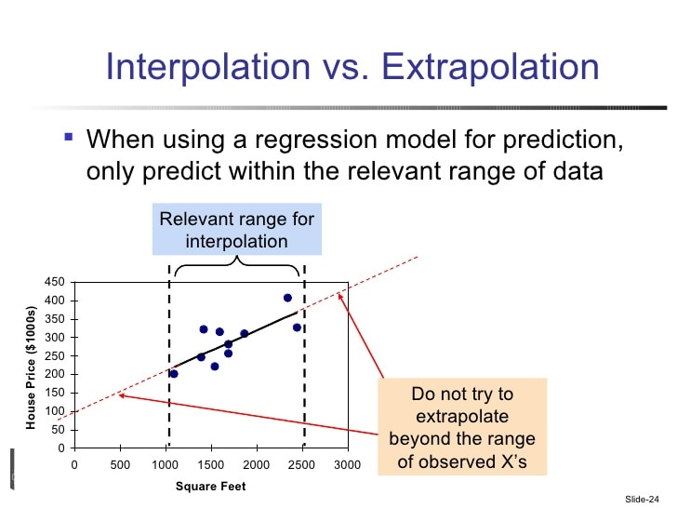

Slide 47
Lesion tolerance:
For the output of an MLP, it is not so important if a weight or a neuron is missing.
It will only worsen a little in total.
If a weight or a neuron is missing in an RBF network then large parts of the output remain practically uninfluenced.
But one part of the output is heavily affected because a Gaussian bell is directly missing.
Spread:
Here the MLP is "advantaged" since RBF networks are used considerably less often – which is not always understood by professionals.
The MLPs seem to have a considerably longer tradition and they are working too good.

Slide 48
Recurrent Neural Network:
RNNs are a powerful and robust type of neural network.
Belong to the most promising algorithms in use because it is the only one with an internal memory.
Because of their internal memory, RNN’s can remember important things about the input they received, which allows them to be very precise in predicting.
The nodes in different layers of the neural network are compressed to form a single layer of recurrent neural networks.
A, B, and C are the parameters of the network.
Works on the principle of saving the output of a particular layer and feeding this back to the input in order to predict the output of the layer.
In RNN, the output of the network at time “t” is used as network input at time “t+1”.

Slide 49
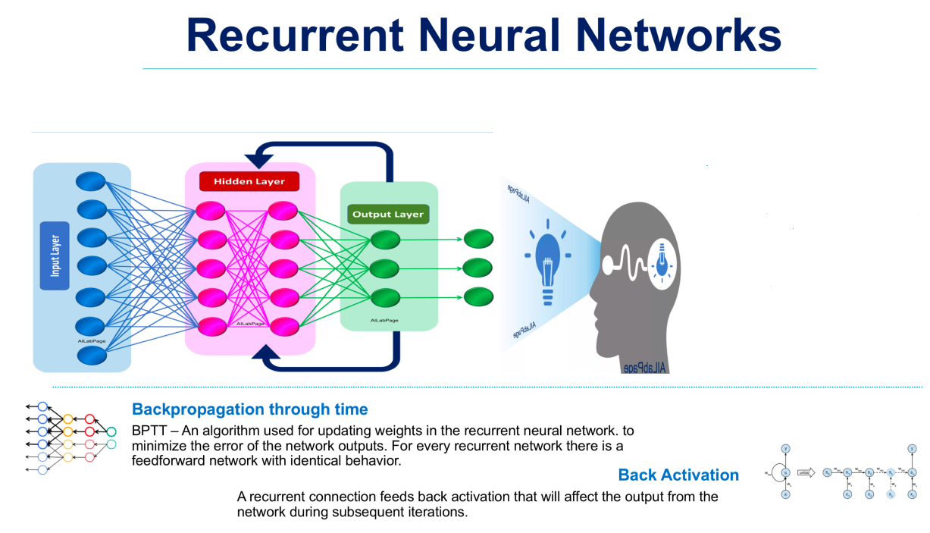

Slide 50
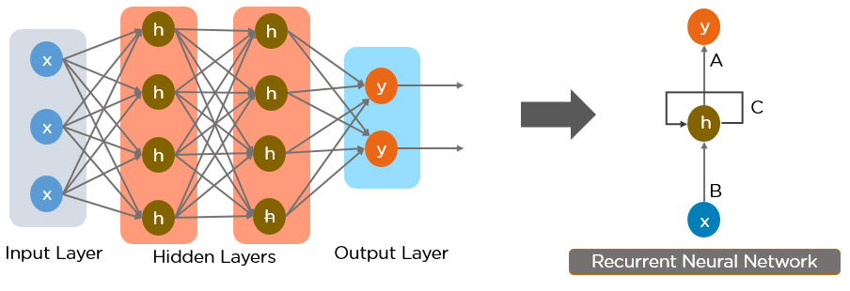
Recurrent perceptron-like networks:
Recurrent networks are networks that are capable of influencing themselves by means of recurrences.
Recurrent multilayer perceptron such a recurrent network is capable to compute more than the ordinary MLP.
If the recurrent weights are set to 0, the recurrent network will be reduced to an ordinary MLP.

Slide 51
Jordan networks:
A Jordan network is a multilayer perceptron with a set K of so-called context neurons k₁, k₂. . . k_{n}.
There is one context neuron per output neuron.
A context neuron just memorizes an output until it can be processed in the next time step.
Therefore, there are weighted connections between each output neuron and one context neuron.
The stored values are returned to the actual network by means of complete links between the context neurons and the input layer.

Slide 53
In Jordan network, the context neurons are recurrent to themselves via a connecting weight.
But most applications omit this recurrence since the Jordan network is already very dynamic and difficult to analyze, even without these additional recurrences.
A context neuron k receives the output value of a neuron at a time t and then reenters it into the network at a time (t +1).

Slide 54
Elman networks:
The Elman networks is an MLP have context neurons, too, but one layer of context neurons per information processing neuron layer.
The outputs of each hidden neuron or output neuron are led into the associated context layer and from there it is reentered into the complete neuron layer during the next time step.
So the complete information processing part1 of the MLP exists a second time as a "context version" – which once again considerably increases dynamics and state variety.
Compared with Jordan networks the Elman networks often have the advantage to act more purposeful since every layer can access its own context.

Slide 56
Training recurrent networks:
Jordan network without a hidden neuron layer for our training attempts so that the output neurons can directly provide input.
This approach is a strong simplification because generally more complicated networks are used.
But this does not change the learning principle.

Slide 57
Unfolding in time:
The back propagation of error, which back propagates the delta values.
In recurrent networks the delta values would back propagate cyclically through the network again and again, which makes the training more difficult.
We cannot know which of the many generated delta values for a weight should be selected for training, i.e. which values are useful.
We cannot definitely know when learning should be stopped.
The advantage of recurrent networks is great state dynamics within the network.

Slide 58
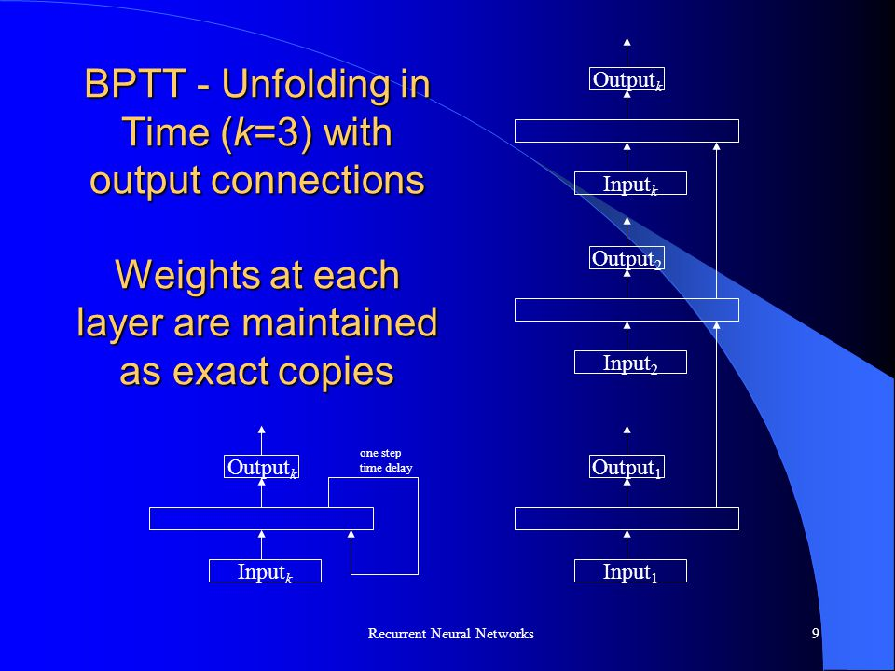

Slide 59
One learning approach would be the attempt to unfold the temporal states of the network.
Recursions are deleted by putting a similar network above the context neurons.
We have to backtrack the recurrences and place "‘earlier"’ instances of neurons in the network thus creating a larger, but forward-oriented network without recurrences.
This enables training a recurrent network with any training strategy developed for non-recurrent ones.
Here the input is entered as teaching input into every "copy" of the input neurons.
This can be done for a discrete number of time steps.
These training paradigms are called unfolding in time.

Slide 60
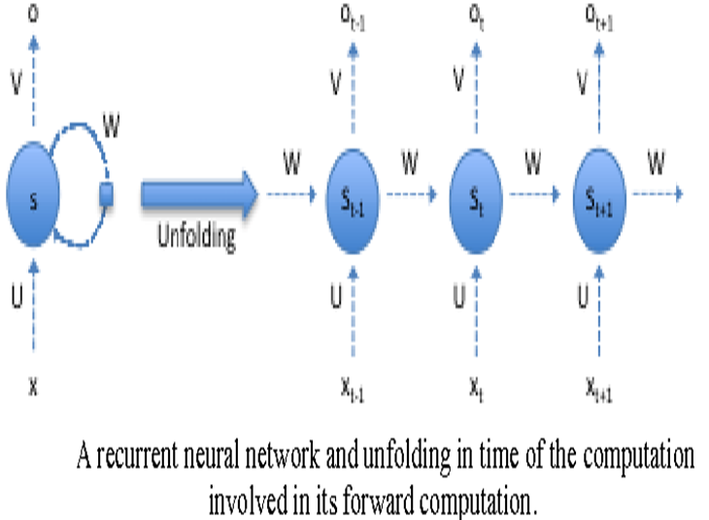

Slide 61
Advantage:
After the unfolding, training by means of backpropagation of error is possible.
Unfolding in time is particularly useful if we receive the impression that the closer past is more important for the network than the one being further away.
The reason for this is that back propagation has only little influence in the layers farther away from the output.
Disadvantages:
The training of such an unfolded network will take a long time since a large number of layers could possibly be produced.
Furthermore, with several levels of context neurons this procedure could produce very large networks to be trained.

Slide 63
Teacher forcing:
Other procedures are the equivalent teacher forcing and open loop learning.
Teacher forcing is a strategy for training recurrent neural networks that uses ground truth as input (teaching input), instead of model output from a prior time step as an input.
They detach the recurrence during the learning process.
We simply pretend that the recurrence does not exist and apply the teaching input to the context neurons during the training.
So, back propagation becomes possible, too.

Slide 64
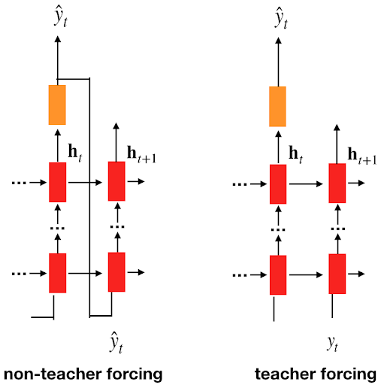

Slide 65
Recurrent back propagation:
Another popular procedure without limited time horizon is the recurrent back propagation.
Training with evolution:
Evolutionary algorithms (constitute a collection of methods that originally have been developed to solve combinatorial optimization problems) have proven to be useful, particularly with recurrent networks, due to the already lengthy training period.
One reason for this is that they are not only limitless in terms of recurrences, but they also offer other benefits when the mutation processes are appropriately chosen.
Neurons and weights, for example, can be adjusted, and the network architecture optimized.
Evolutionary techniques, on the other hand, are less common with regular MLPs since they need significantly more time than a directed learning procedure like back propagation.

